Slide 1


AURA-Twin
Automated Understanding & Real-time Analysis Twin
Prepared by
Rawan Suliman Raghad Shaaban
Supervised by
Dr.Kadan Aljouma
Eng.Wesam Alsouhli
Eng.Zeinab Baghdadi

Slide 2
AURA-Twin
Automated Understanding & Real-time Analysis Twin
Prepared by
Rawan Suliman Raghad Shaaban
Supervised by
Dr.Kadan Aljouma
Eng.Wesam Alsouhli
Eng.Zeinab Baghdadi

Slide 3
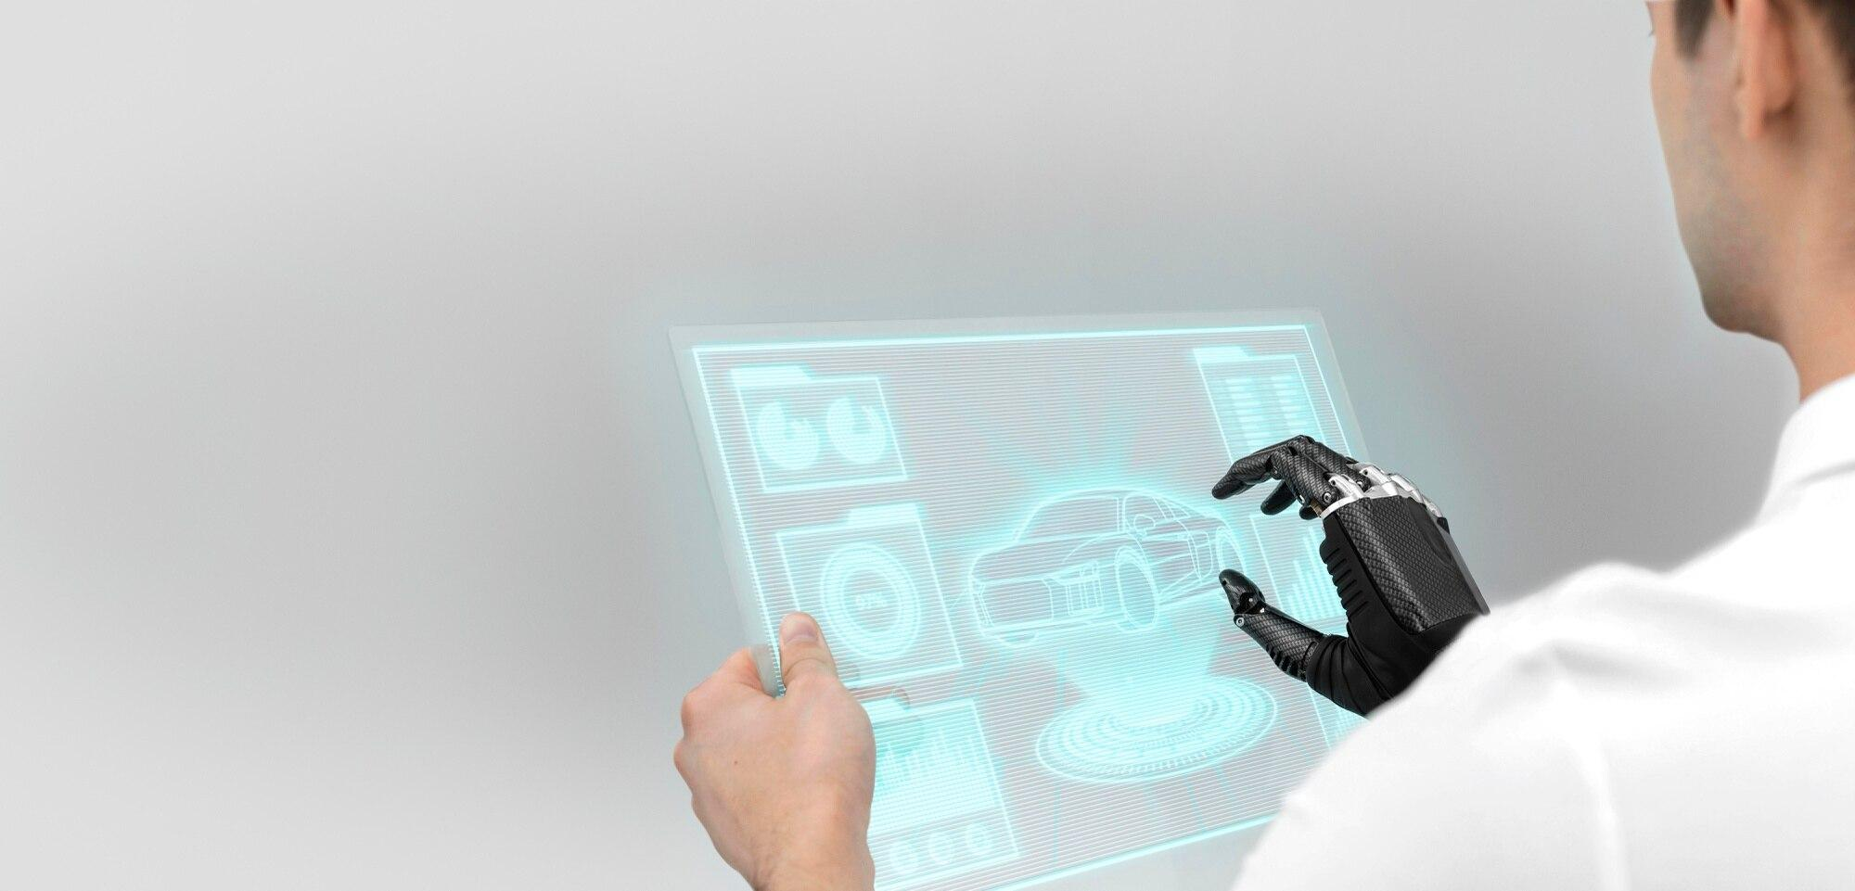
Problem Statement
1. Inefficient Maintenance:
Issue: Relying on reactive or rigid schedules.
Impact: High costs from sudden failures or wasted parts.
2. Complex Sensor Noise:
Issue: Massive vibration data is too noisy for manual analysis.
Impact: Faults stay hidden until catastrophic damage occurs.
3. The "Intelligence" Gap:
Issue: Lack of "smart translators" for raw sensor data.
Impact: Missed opportunities for early prediction and intervention.

Slide 4
Project Objectives
1. 24/7 Virtual Health Monitoring
2. Predictive Fault Forecasting
3. Cost & Lifetime Optimization
4. Hardware-Free Innovation

Slide 5
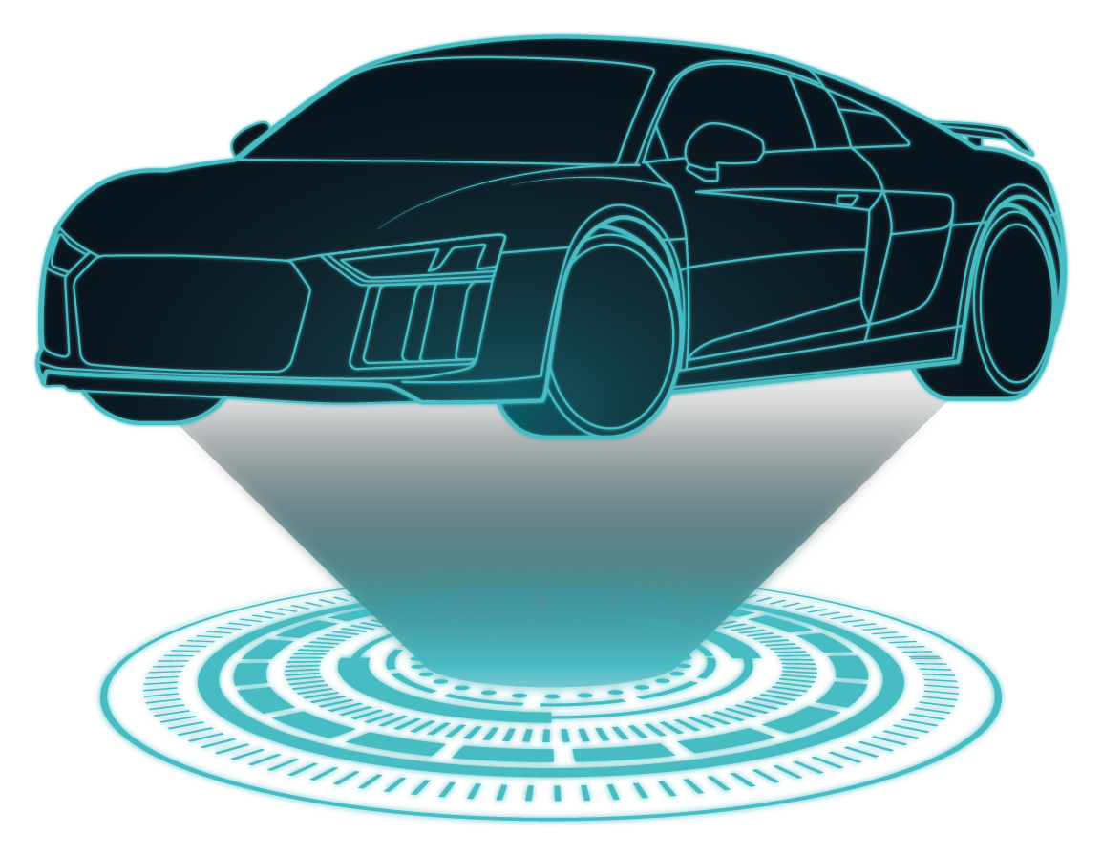
Project Benefits
1. Asset Longevity Enhancement:
Proactively detecting minor anomalies before they escalate into catastrophic failures, thereby extending the operational lifespan of the equipment.
2. Public & Operational Safety:
Mitigating the risks of accidents and hazards caused by sudden, unforeseen engine malfunctions.
3. Data-Driven Decision Support:
Empowering engineers with high-fidelity, real-time insights into engine health to facilitate informed maintenance decisions.

Slide 6
THE MODEL USED IN AURA-TWIN
"Our methodology involves training three distinct
models: a CNN, an LSTM, and a Hybrid CNN-LSTM
architecture to evaluate and compare their
effectiveness in engine state classification."
CNN
LSTM
CNN&LSTM
Hybrid

Slide 7
Table of research papers
Research Paper Name | Publication Year | Dataset Used | Training Approach | AI Model | Feature Extraction | Evaluation & Result
Data-Driven Digital Twin Framework for Predictive Maintenance | 2025 | Multiple Industry Datasets (including milling and engine data) | Supervised Learning & Data-Driven Modeling | CNN, LSTM, and Hybrid Variants | Deep Learning-based (Automatic feature extraction) | 94.2% Accuracy (Average reliability across different datasets)
A Survey on Deep Learning based Time Series Analysis | 2025 | General Time Series Datasets (Sensing, Finance, Health) | 80/20 train-test split with hyperparameter tuning using Grid Search and Randomized Search | CNN, RNN, Transformers, GNN | Frequency Transformation (Fourier, Wavelet, etc.) | 90% - 95% Accuracy range (Depending on the frequency domain method)
Comparison of deep learning models for predictive maintenance | 2025 | Three Industrial Datasets (Sensor Data) | 70/15/15 split, Adam optimizer, and SMOTE for balancing imbalanced classes. | Hybrid CNN-LSTM | Automatic extraction of spatial and temporal features | 96.1% Accuracy (The highest performance among all tested models)
Predictive Maintenance for Vehicle Performance using Bidirectional LSTM | 2024 | Real-time vehicle sensor datasets including engine parameters (RPM, Temperature, Fuel), braking systems data, and tire health metrics. | Supervised Learning using a time-series approach to predict the Remaining Useful Life (RUL) and detect potential failures. | Physics-Informed Neural Networks (PINNs) for stator flux estimation; Support Vector Machine (SVM) for fault classification. | Automated temporal feature extraction from multivariate sensor streams (Time-domain analysis of vibration, pressure, and thermal signals). | Evaluated using metrics like RMSE and Accuracy. The Bi-LSTM outperformed standard LSTM and SVM models, providing highly precise failure forecasting and robust handling of sensor noise.

Slide 8
Table of research papers
Research Paper Name | Publication Year | Dataset Used | Training Approach | AI Model | Feature Extraction | Evaluation & Result
Predictive Maintenance for Vehicle Performance using Bidirectional LSTM | 2024 | Real-time vehicle sensor datasets including engine parameters (RPM, Temperature, Fuel), braking systems data, and tire health metrics. | Supervised Learning using a time-series approach to predict the Remaining Useful Life (RUL) and detect potential failures. | Physics-Informed Neural Networks (PINNs) for stator flux estimation; Support Vector Machine (SVM) for fault classification. | Automated temporal feature extraction from multivariate sensor streams (Time-domain analysis of vibration, pressure, and thermal signals). | Evaluated using metrics like RMSE and Accuracy. The Bi-LSTM outperformed standard LSTM and SVM models, providing highly precise failure forecasting and robust handling of sensor noise.
Hybrid digital twin-based fault diagnosis framework for PMSMs in electric vehicle applications | 2025 | Kaggle dataset "Electric Motor Temperature". Includes time-series sensor data: dq-axis voltages/currents, speed, torque, and multiple temperature measurements (ambient, coolant, PM, stator yoke/tooth/winding). | Hybrid Digital Twin (HDT) framework combining Physics-Informed Neural Networks (PINNs), Extended Kalman Filter (EKF) sensor fusion, and residual analysis. Training involves physics-constrained loss and EKF state refinement. | Physics-Informed Neural Networks (PINNs) for stator flux estimation; Support Vector Machine (SVM) for fault classification. | Park transformation (dq-axis), Fast Fourier Transform (FFT) of current signals, temperature gradients, and residual errors between measured and predicted signals. | Fault detection accuracy: 96.99%. Precision: 90.09%, Recall: 89.21%, F1-score: 89.65%. Detection latency <95 ms, 31% reduction in false positives. Outperforms MCSA by ~13%.

Slide 9
Dataset Description
"This project utilizes the FordA dataset from the UCR Time Series Archive, a globally recognized benchmark in time-series data mining. The dataset consists of engine vibration sensor readings, where each sample represents a complete engine operational cycle. The data is labeled with binary classifications, clearly distinguishing between healthy and faulty engine states."

Slide 10
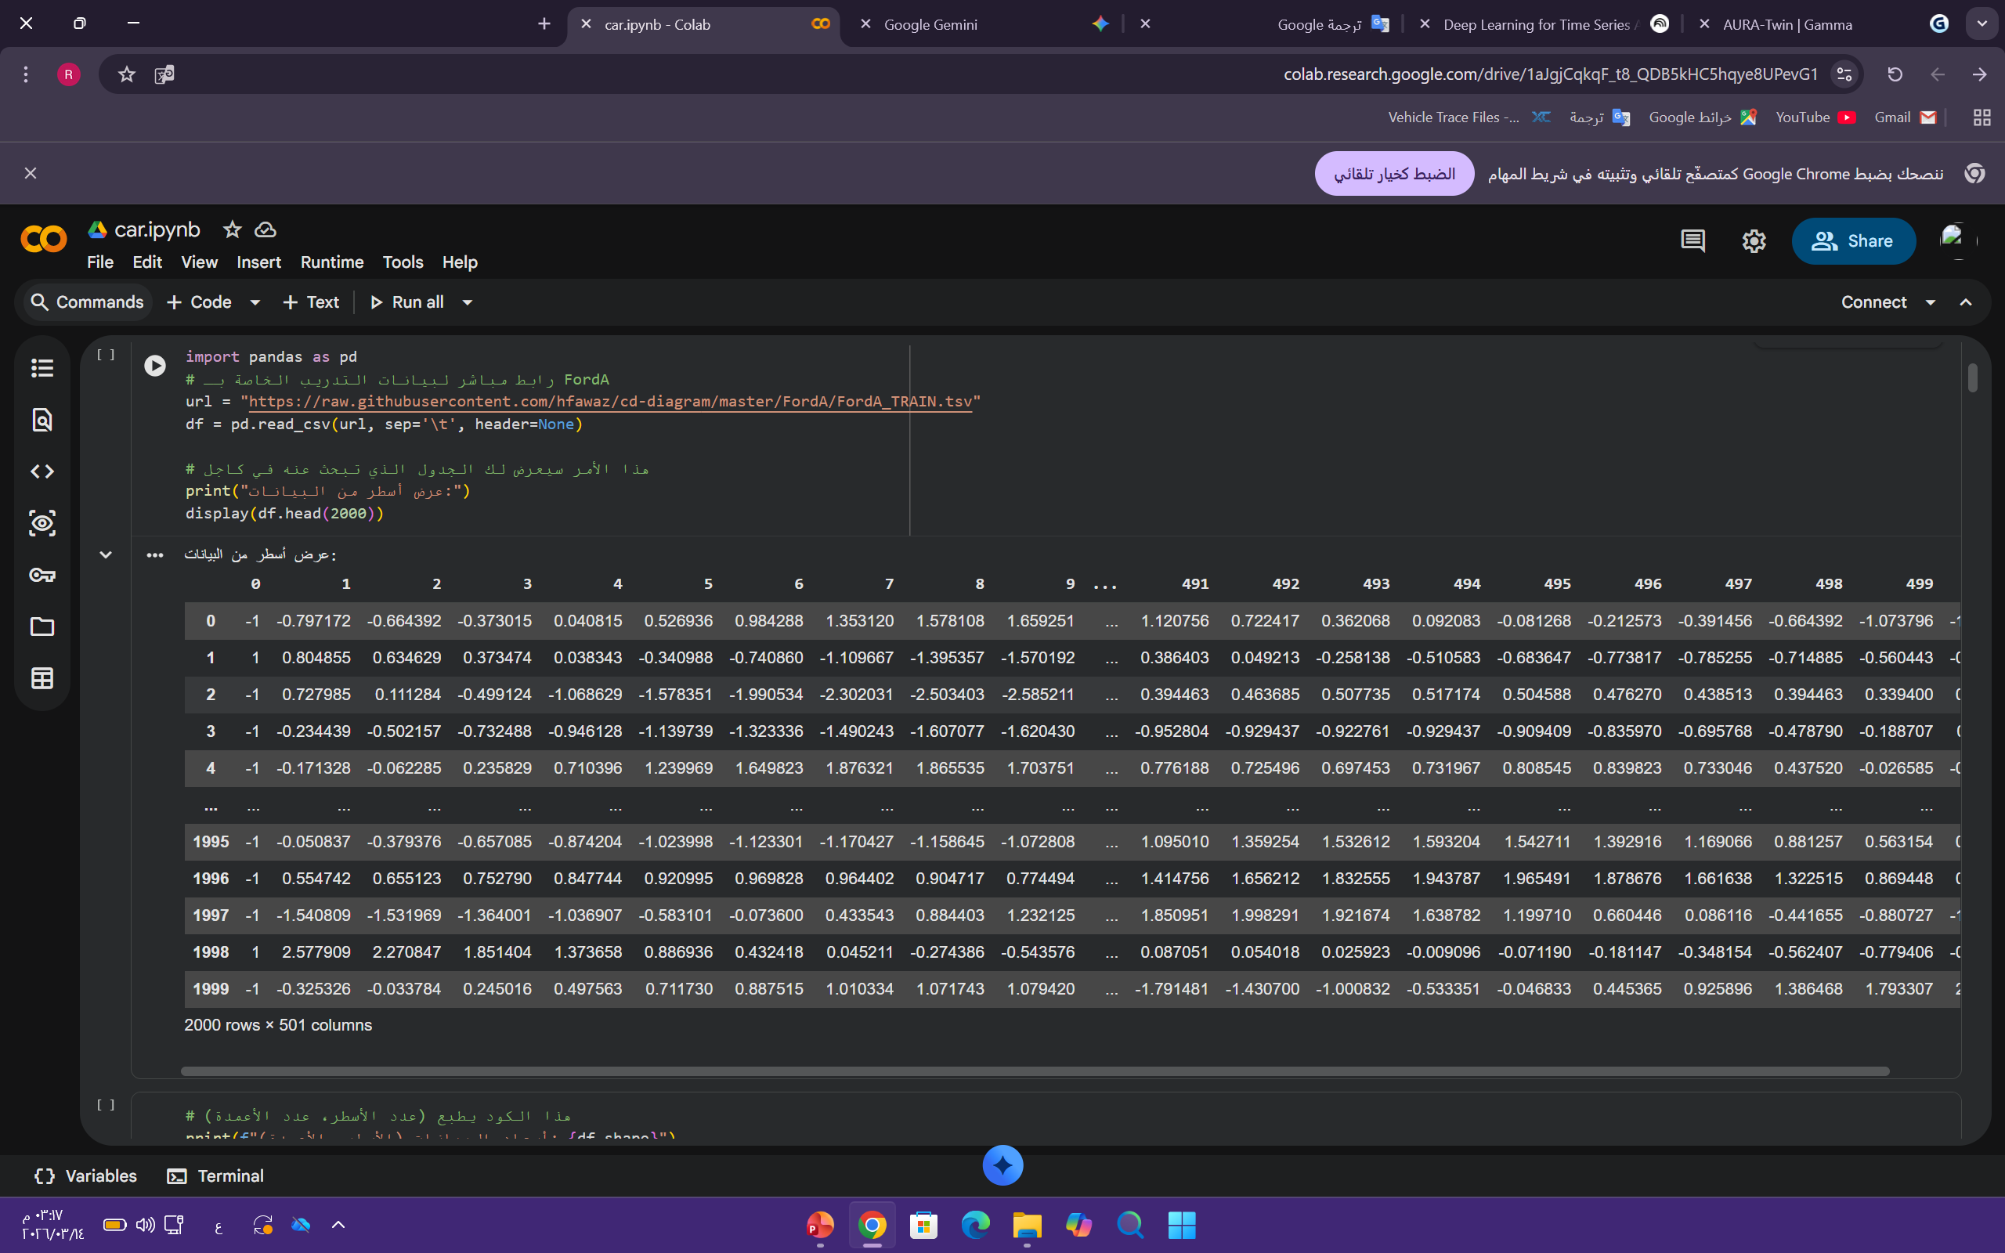
"The dataset consists of 501 columns. The first column, named 'target', represents the class label (1 for healthy, -1 for faulty). The remaining 500 columns represent a sequence of sensor measurements taken over time, capturing the vibration signature of the engine. Each row is a unique sample of the engine's operational state."Stay tuned for more updates on this exciting development as we continue to innovate and push the boundaries of what's possible!

Slide 11
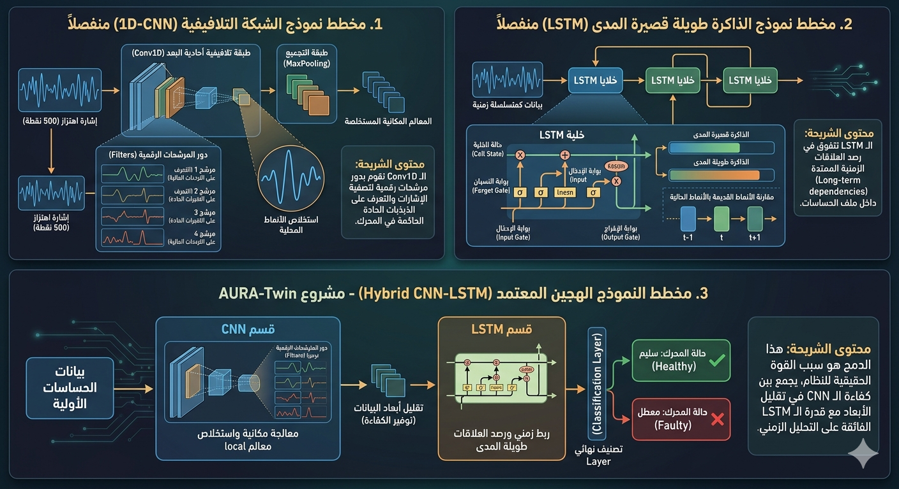
Model Architectures Overview
1. CNN Model (Convolutional Neural Network)
Architecture: Composed of 1D Convolutional layers (Conv1D) followed by MaxPooling layers.
Mechanism: Acts as a digital filter to automatically extract Spatial Features and structural patterns from raw vibration signals.
Primary Goal: Filtering noise and reducing the high-dimensional raw data into a meaningful "Feature Map."

Slide 12
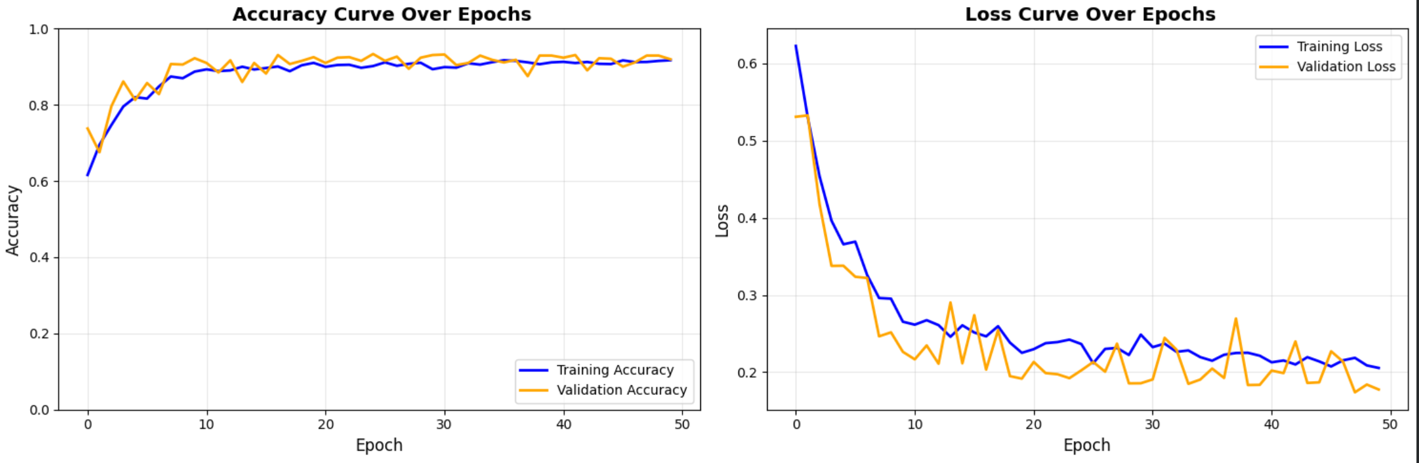
Model Comparison & Performance Results
1. CNN Model (Convolutional Neural Network)
Role: Extracting spatial features from raw vibration signals.
Performance: Achieved high training accuracy but suffered from a "Generalization Gap" between training and testing.
Accuracy: ~84%
Conclusion: Effective at pattern recognition, but lacks the ability to capture the temporal dependencies of the signal.

Slide 13
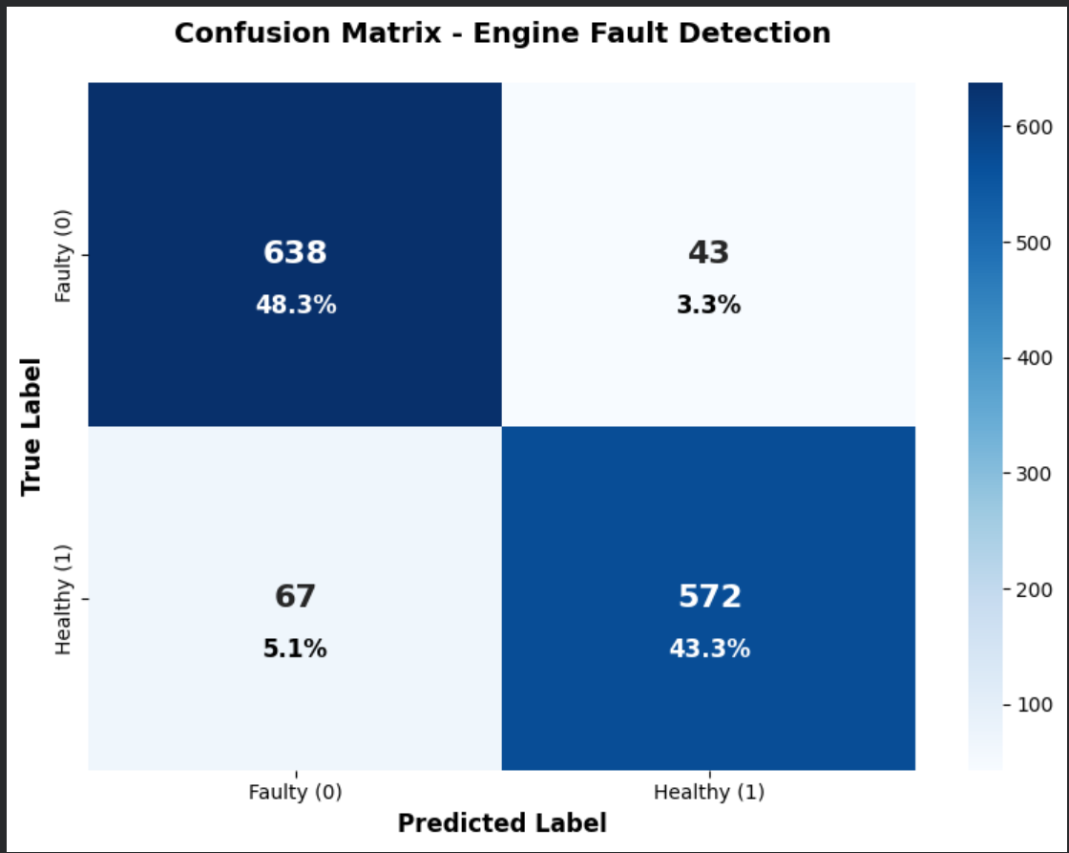
Model Comparison & Performance Results
1. CNN Model (Convolutional Neural Network)
Role: Extracting spatial features from raw vibration signals.
Performance: Achieved high training accuracy but suffered from a "Generalization Gap" between training and testing.
Accuracy: ~84%
Conclusion: Effective at pattern recognition, but lacks the ability to capture the temporal dependencies of the signal.

Slide 14
Model Architectures Overview
2. LSTM Model (Long Short-Term Memory)
Architecture: Consists of specialized LSTM units equipped with input, forget, and output gates.
Mechanism: Utilizes a feedback loop to capture Temporal Dependencies, allowing the model to "remember" the sequence of vibrations over time.
Primary Goal: Modeling the time-domain relationships and the flow of the engine signal to detect long-term anomalies.

Slide 15
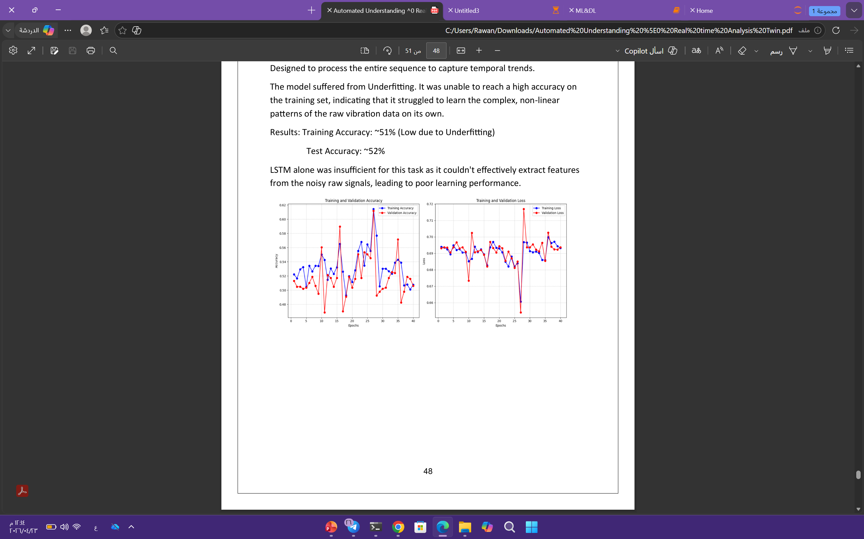
Model Comparison & Performance Results
2. LSTM Model (Long Short-Term Memory)
Role: Analyzing the temporal sequences and time-domain dependencies of vibrations.
Performance: Struggled to process raw data directly, leading to significant Underfitting.
Accuracy: ~52% (Poor performance as a standalone model).
Conclusion: Inefficient at feature extraction from noisy signals without extensive preprocessing.

Slide 16
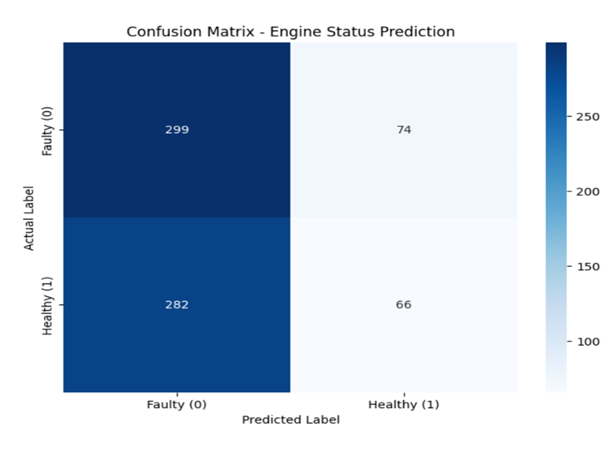
Model Comparison & Performance Results
2. LSTM Model (Long Short-Term Memory)
Role: Analyzing the temporal sequences and time-domain dependencies of vibrations.
Performance: Struggled to process raw data directly, leading to significant Underfitting.
Accuracy: ~52% (Poor performance as a standalone model).
Conclusion: Inefficient at feature extraction from noisy signals without extensive preprocessing.

Slide 17
Model Architectures Overview
3. Proposed Hybrid CNN-LSTM Model
The Concept: A unified framework that merges the feature extraction power of CNNs with the sequential memory of LSTMs.
Key Components:
  Input Layer: Receives the 500-timestep vibration signal.
  CNN Blocks: For automated feature engineering and signal denoising.
  Batch Normalization: To ensure fast and stable training convergence.
  LSTM Layer: To analyze the temporal order of the extracted features.
  Regularization: Uses Dropout and L2 Regularization to prevent overfitting.
Final Result: The optimal diagnostic engine for AURA-Twin, achieving a peak accuracy of 93.34%.

Slide 18
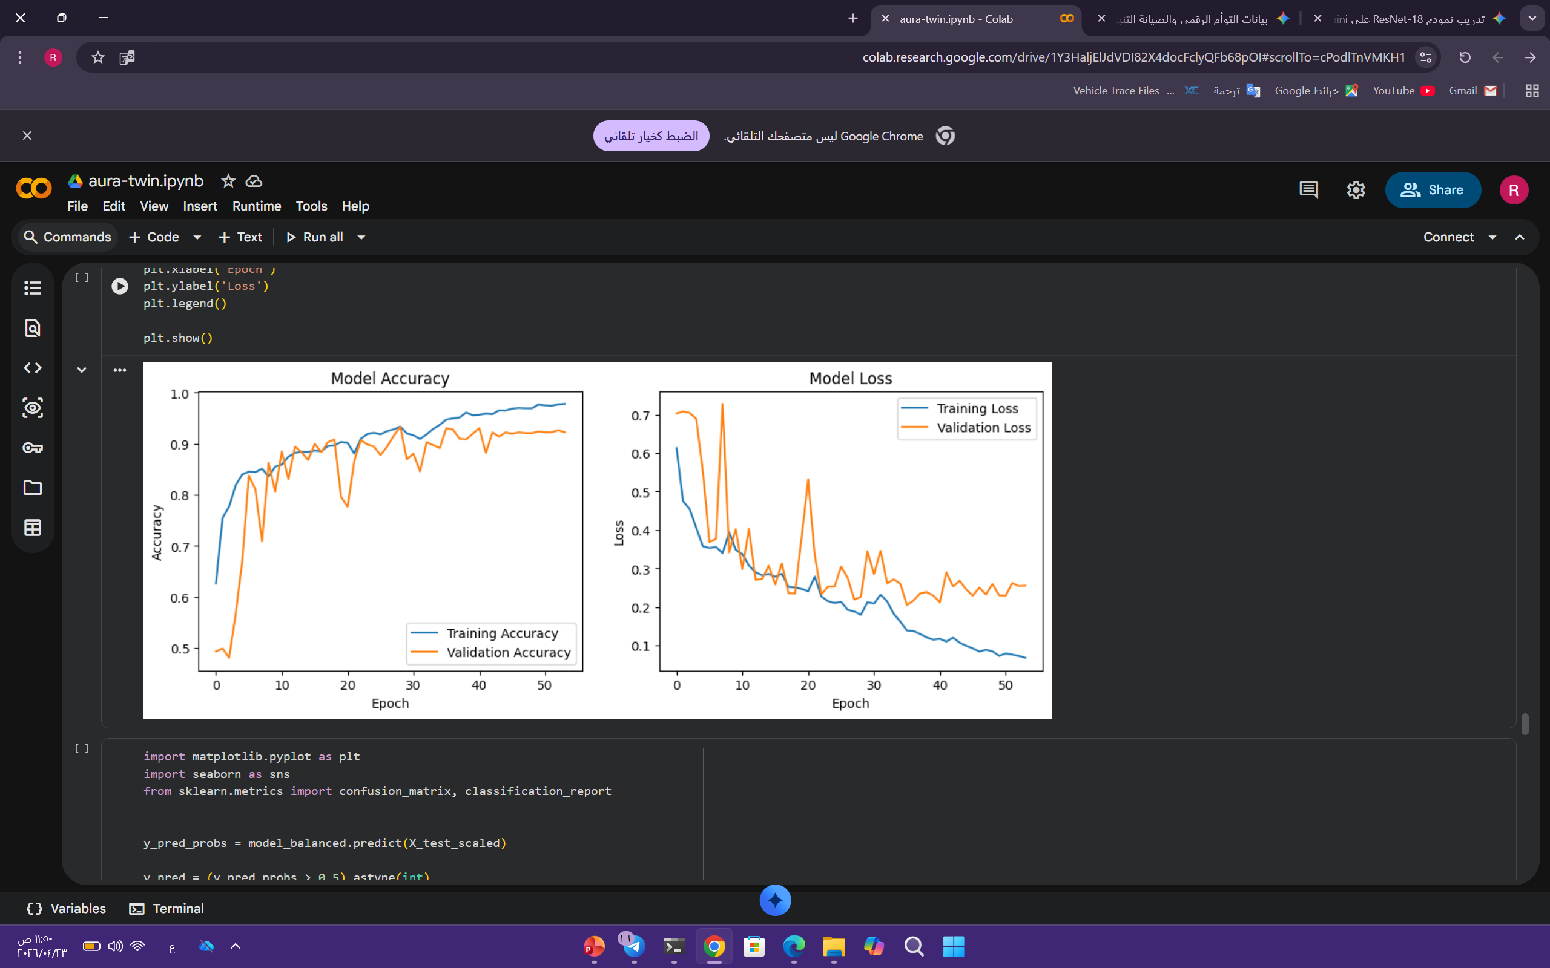
Model Comparison & Performance Results
3. Proposed Hybrid CNN-LSTM Model
Role: Integrating CNN’s ability to filter noise and extract features with LSTM’s strength in temporal memory analysis.
Performance: Demonstrated the most stable learning curve and achieved the best balance between precision and stability.
Accuracy: 93.34%
Conclusion: The optimal model for the "Digital Twin" system due to its superior generalization capabilities and high predictive accuracy.

Slide 19
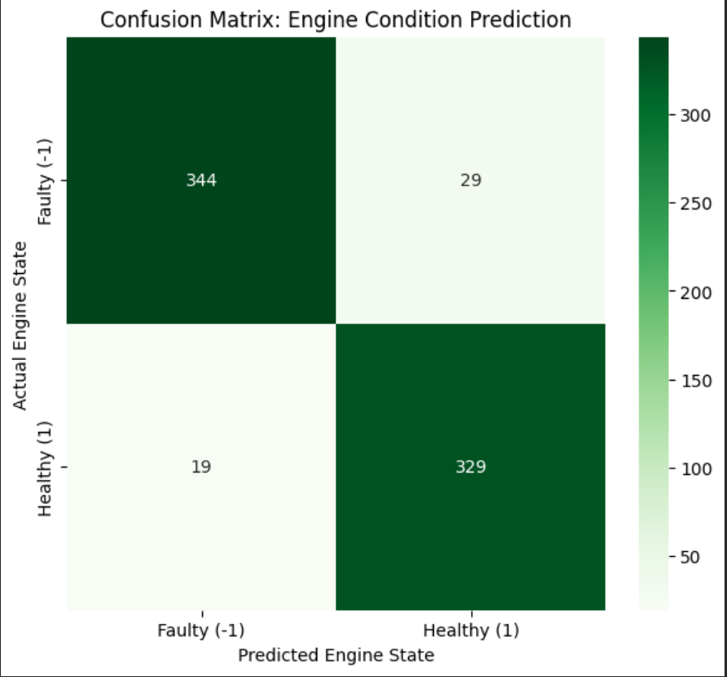
Model Comparison & Performance Results
3. Proposed Hybrid CNN-LSTM Model
Role: Integrating CNN’s ability to filter noise and extract features with LSTM’s strength in temporal memory analysis.
Performance: Demonstrated the most stable learning curve and achieved the best balance between precision and stability.
Accuracy: 93.34%
Conclusion: The optimal model for the "Digital Twin" system due to its superior generalization capabilities and high predictive accuracy.

Slide 20
Results table
85%
Model Architecture | Training Accuracy | Test Accuracy | Status
LSTM Alone | 51% | 52% | Failed
CNN Alone | 85% | 84% | Moderate
Hybrid CNN-LSTM | 94% | 93.3% | Best (AURA-Twin)
85%
85%
85%
51%
52%

Slide 21
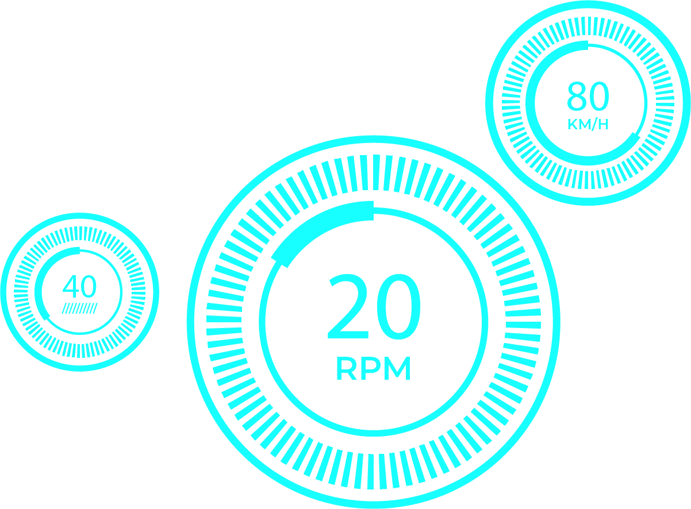
“Thank You”

